Slide 1
OFFLINE SIGNATURE VERIFICATION USING CONVOLUTIONAL NEURAL NETWORKS
M. Karthik –
14CS01022
Guide
Dr.N.b puhan

Slide 2
Contents
Introduction and Problem
Motivation and Challenges
Problem Definition
Related Work
Proposed Work
Future Work and Conclusion
References

Slide 3
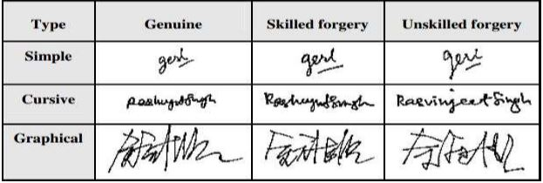
Introduction
A signature is a person's name written in a distinctive way as a form of identification in authorizing a check or document or concluding a letter.
Signature forgery refers to the act of falsely replicating the signature of another person.
Why signature forgery is done?

Slide 4
Introduction…
Signature verification or forgery can be verified in two Methods :
1) Online Signature Verification
2) Offline Signature Verification

Slide 5
Challenges
Differentiating different parts of signature that varies with each signing
Isolating the sector of interest from the total input image.
Signature orientation can be different.
Input image may also contain noise.

Slide 6
Problem Definition
Our main objective is to develop a method that will calculate features of a signature and verify it by using convolutional neural networks.

Slide 7
Related Work
Research has been done using local features and global features like geometric features of the signature.
GRID MODEL:
1)Image is partitioned into 8 horizontal parts
2)each part is partitioned into 12 boxes and calculate the summation of the angles of all points in each box taken with respect to the bottom left corner and normalize it for feature.
The area of Handwritten signature verification has been broadly researched in the last decades, but remains an open research problem.

Slide 8
PROPOSED METHOD
Two-stage approach
1)Writer-independent feature learning phase .
2)writer-dependent classification.
Dataset is partitioned into two distinct sets:
1)Devolpment set(learning feature representation)
2)Exploitation set (Train the classifiers)

Slide 9
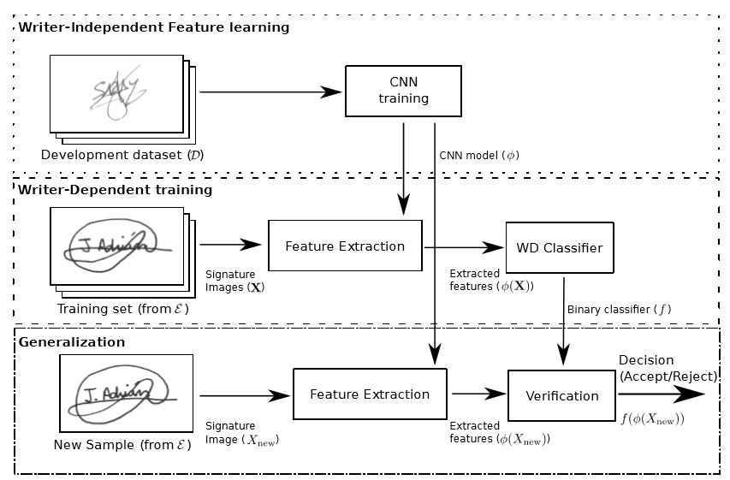
Proposed architecture

Slide 10
Pre-processing
For all the signatures from both the datasets(D and E), we apply the same pre-processing strategy.
1)Size normalization and centering.
2)Removing the noise(using filters)
3)Removing the background.

Slide 11
Writer-independent in feature learning
In this process, we use a separate set of users( development set D) to learn the features.
In development data set we have both genuine and forged signatures.
The objective is to separate both genuine and forged signatures.

Slide 12
Writer dependent classification
After the CNN is trained in the set D, we use it to extract features for the writer-dependent training.
For each user we build a writer-dependent training and testing set
Training set:
Genuine signature for the user(positive examples) and genuine signature from other user(negative examples)
Testing set:
Genuine signature of the user and skilled forgeries made for the user.

Slide 13
Future work and conclusion
Access to more resources would allow us to achieve better performance on our main task.
Being able to train on a larger dataset with more signature examples per person could achieve higher accuracies.
Convolutional neural networks does an excellent job of verifying signatures when allowed access during training to examples of genuine and forged signatures of the same people whose signatures are seen at test time.
We present a good understanding on machine learning techniques for signature verification.

Slide 14


References
A. K. Jain, A. Ross, and S. Prabhakar, “An introduction to biometric recognition,” Circuits and Systems for Video Technology, IEEE Transactions on, vol. 14, no. 1, pp. 4–20, 2004.
A. Krizhevsky, I. Sutskever, and G. E. Hinton, “ImageNet Classiﬁcation with Deep Convolutional Neural Networks,” in Advances in Neural Information Processing Systems 25, 2012, pp. 1097–1105.
L. G. Hafemann, R. Sabourin, and L. S. Oliveira, “Ofﬂine Handwritten Signature Veriﬁcation-Literature Review,” arXiv preprint arXiv:1507.07909, 2015.
M. Ferrer, M. Diaz-Cabrera, and A. Morales, “Static Signature Synthesis: A Neuromotor Inspired Approach for Biometrics,” Pattern Analysis and Machine Intelligence, IEEE Transactions on, vol. 37, no. 3, pp. 667–680, Mar. 2015.

